Slide 1
Spatio-temporal analysis of oil productive zones within Oil and Gas Authority dataset of UK’s continental basin
IBM Advanced Data Science Project
By Upasana Dhar
A multi layer perceptron machine-learning approach

Slide 2
01
AIM
A
Spatio-temporal analysis of oil productive zones
B
C
D

Slide 3
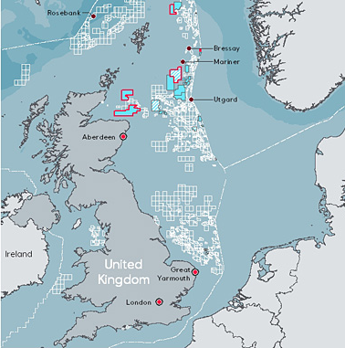
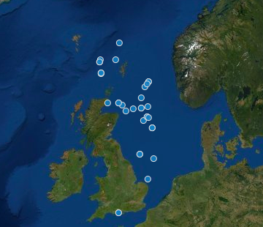
Study Area :
Field areas in UKCS-UK’s Continental shelf
Data sets available from UK’s Oil and Gas authority

Slide 4
Motivation :
Here we see the trends of oil and water production in the area at each location from year 1975 to 2019.
Using a neural network which can classify zones within categories :
a. Above profitable margin or b. Below profitable margin

Slide 5
02
METHOD
A
B
Classification of oil productive zones (production limit 65,000) based on Multi layer perceptron approach
C
D

Slide 6
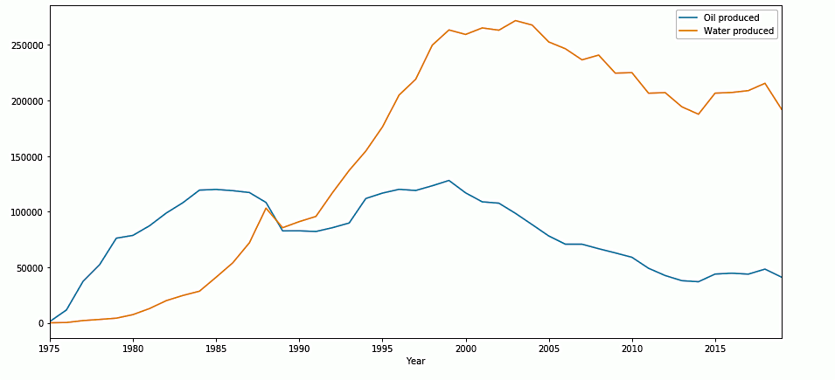
Temporal variation of oil production across OGA’s fieldareas

Slide 7
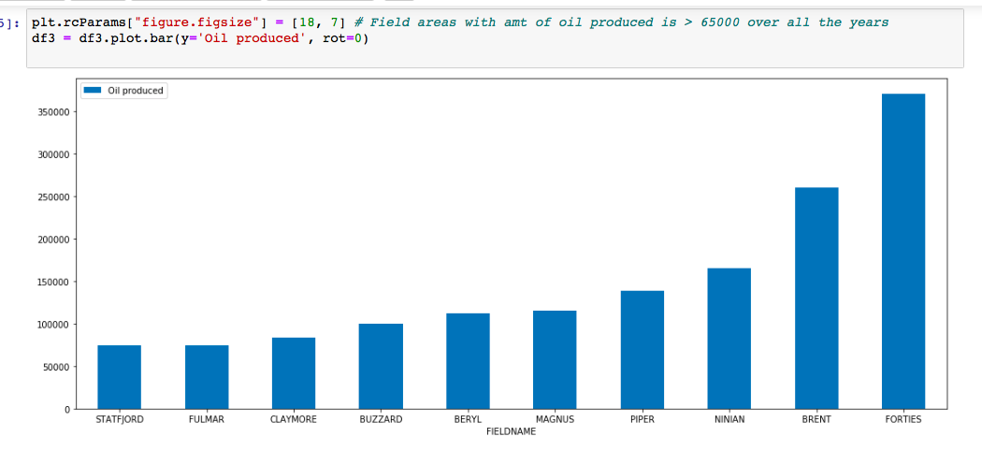
Spatial variation in oil production across OGA’s fieldareas
Highest total oil produced in the fieldareas over the years from 1975-2019

Slide 8
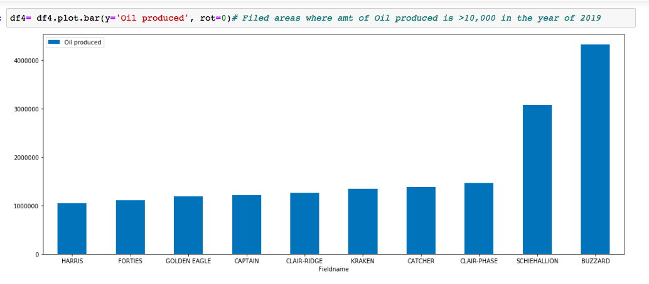
Spatial variation in oil production across OGA’s fieldareas
Highest total oil produced in the fieldareas in the current time on 2019

Slide 9
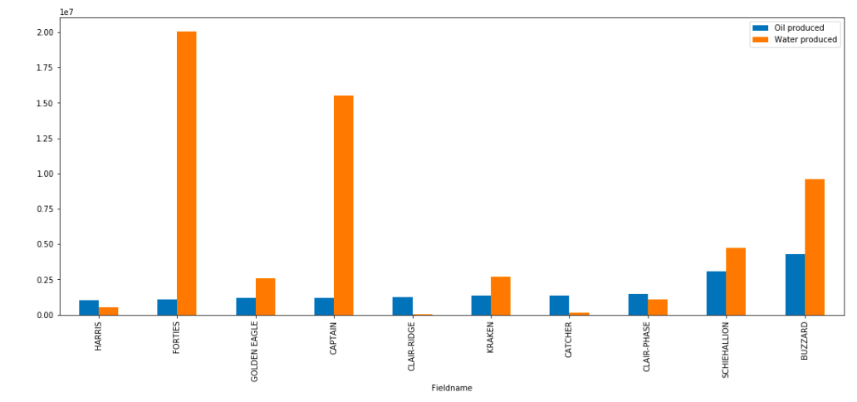
Relation between total oil produced and total water produced at field areas on 2019

Slide 10
Observations
The field areas reach a mature stage when the production of oil decreases and water increases.
A more productive field area will less water produced as compared to oil.
These are related to other factors too.
Here we see that, currently Buzzard and Schiehallion are more proliferous zones even though the total oil produced from the areas Forties and Brent are higher over all the years.

Slide 11
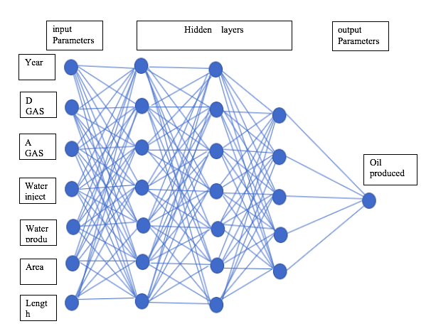
Method : ADD of the network
Binary classifier
7 neurons in input layer as there are 7 features and 3 hidden layers with 7,7,5 neurons in each respectively

Slide 12
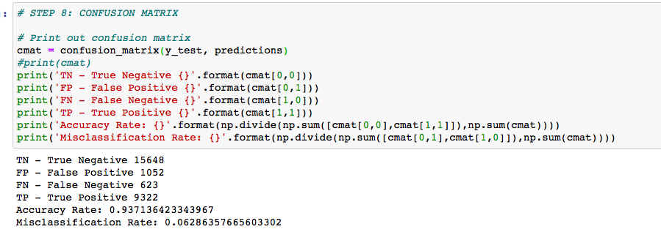
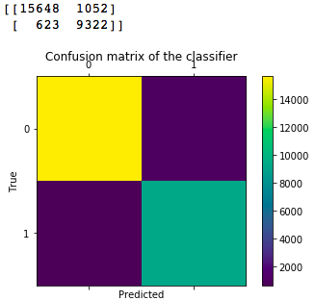
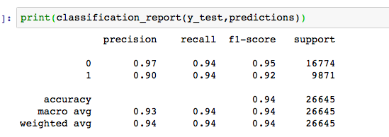
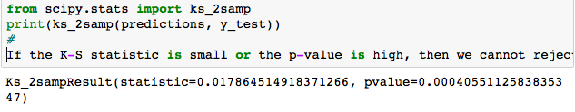
MLP Model accuracy:- Confusion Matrix
Model Evaluation
Kolmogorov Smirnov statistic:

Slide 13
04
CONCLUSION
A
From the model predictions, we can suggest that this approach can be used to predict areas of profitable oil production given a set of input parameters of the bore holes.
B
C
We can use this method with varying other input parameters, which was beyond the scope of this report.
D

Slide 14
Thanks! Questions??

